Slide 1

Measurement of Toxicity Levels in Sentences using NLP and CNN with Word Embedding System
Group members (Group 11)
Mahmudul Hasan Shakil - 21166034
Zawad Alam - 21166035
Sajal Kanti Kundu - 21166006
Arnob Kumar Dey - 21166011

Slide 2
Introduction
01
02
03
Objective
Implementation of deep learning for specifying abusive online contents to reduce cyberbullying
Motivation
Impact of cyberbullying and online harassment
Our Ideas
System for reducing the impacts of cyberbullying and harassment

Slide 3
Objective
Specifying abusive contents
01
02
Reducing cyberbullying
Implementation of deep learning for labeling vulgarity in social media
03
04
Build faster and more accurate model

Slide 4
Our Ideas
Implementation of a system
Distinguishing toxic and non toxic verbal comments
Data preprocessing using NLP
Classify toxic words using CNN with fasttext word embedding technique

Slide 5
Our Ideas
Classify into different sub categories
Finding the accuracy of the process
Comparing with the previous works

Slide 6
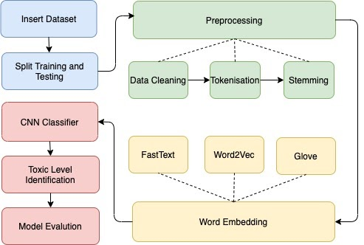
Workflow
Phase 1
Phase 2
Phase 3
Data preprocessing
Word embedding
CNN architecture for classification

Slide 7
Limitations
1. Dataset upgradation and variation
2. Lack of communication

Slide 8
Conclusion
Representation of comment classification system as it is a vital issue in social media
Implementing CNN with fasttext word embedding technique after processing using NLP
In proposed work fetches toxic words and clarifies it's subclasses
Despite of having a high accuracy, it can be increased using improved dataset

